Slide 1

Software Design and Arcitecture(SDA) Lecture 3
Engr.Ramsha Mashood
Senior Lecturer
Department of Software Engineering
Bahria University Karachi Campus

Slide 2




System Design & Software Architecture; Object Design, Mapping Design to Code

Slide 3
TEXT BOOK
Object-Oriented Analysis, Design and Implementation, Brahma Dathan, Sarnath Ramnath, Latest Edition, Universities Press

Slide 4
REFERENCE BOOK
2. Software Engineering: A Practitioner’s Approach, Roger S. Pressman, Bruce R. Maxim, 8th Ed, McGraw-Hill Education, 2015. 3.
3. Essential Software Architecture, Gorton I., latest Edition, Springer – Verlag

Slide 5

SOFTWARE DESIGN
Software design is a mechanism to transform user requirements into some suitable form, which helps the programmer in software coding and implementation. It deals with representing the client's requirement, as described in SRS (Software Requirement Specification) document, into a form, i.e., easily implementable using programming language..

Slide 6
purpose of SOFTWARE DESIGN
Translation of Requirements:
Objective: To translate the system requirements into a detailed and complete design that can be implemented.
Importance: Helps in understanding how the software will fulfill the specified needs and functionalities.
Blueprint for Construction:
Objective: To provide a blueprint or plan for the construction of the software system.
Importance: Serves as a guide for developers, ensuring a systematic and organized implementation process.
Communication:
Objective: To facilitate communication among team members, stakeholders, and other involved parties.
Importance: Ensures a common understanding of the software's architecture and design decisions, reducing the risk of misinterpretation.

Slide 7
purpose of SOFTWARE DESIGN
Risk Reduction:
Objective: To identify and address potential risks and challenges early in the development process.
Importance: Minimizes the likelihood of errors, design flaws, and misunderstandings that could lead to costly corrections later in the development cycle.
Maintenance and Evolution:
Objective: To create a design that is modular, adaptable, and easy to maintain.
Importance: Facilitates future updates, modifications, and enhancements to the software system, extending its lifespan and usability.
Resource Optimization:
Objective: To optimize the use of resources such as time, memory, and processing power.
Importance: Ensures that the software is efficient and performs well, meeting performance expectations and requirements.

Slide 8
Elements of Software Design:
Architectural Design:
Description: Defines the overall structure of the software, including components, modules, and their relationships.
Components: High-level design, system architecture.
Module Design:
Description: Breaks down the system into smaller, manageable modules with well-defined responsibilities.
Components: Module specifications, interface design.
Data Design:
Description: Specifies the data structures, databases, and data flow within the software.
Components: Data models, database design.

Slide 9
Elements of Software Design:
Interface Design:
Description: Defines how different components or modules interact with each other and with external entities.
Components: Interface specifications, communication protocols.
Algorithmic Design:
Description: Involves designing algorithms and procedures to perform specific tasks efficiently.
Components: Algorithm design, decision structures.
User Interface (UI) Design:
Description: Focuses on creating a positive and intuitive user experience.
Components: Layout, navigation, visual elements.
Error Handling and Exception Handling:
Description: Plans for how the software will respond to unexpected situations or errors.
Components: Error detection, recovery strategies.

Slide 10
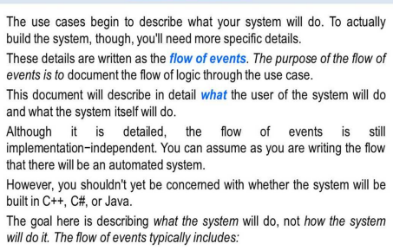
Flow of events

Slide 11
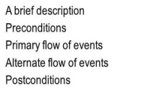
Flow of events

Slide 12
Uml to code

Slide 13
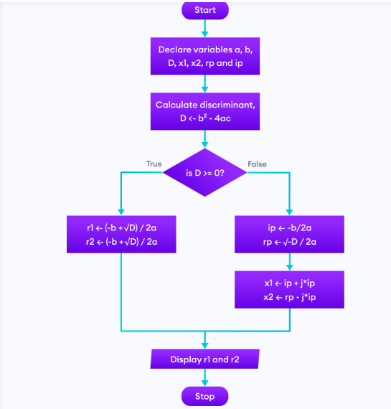

Slide 14
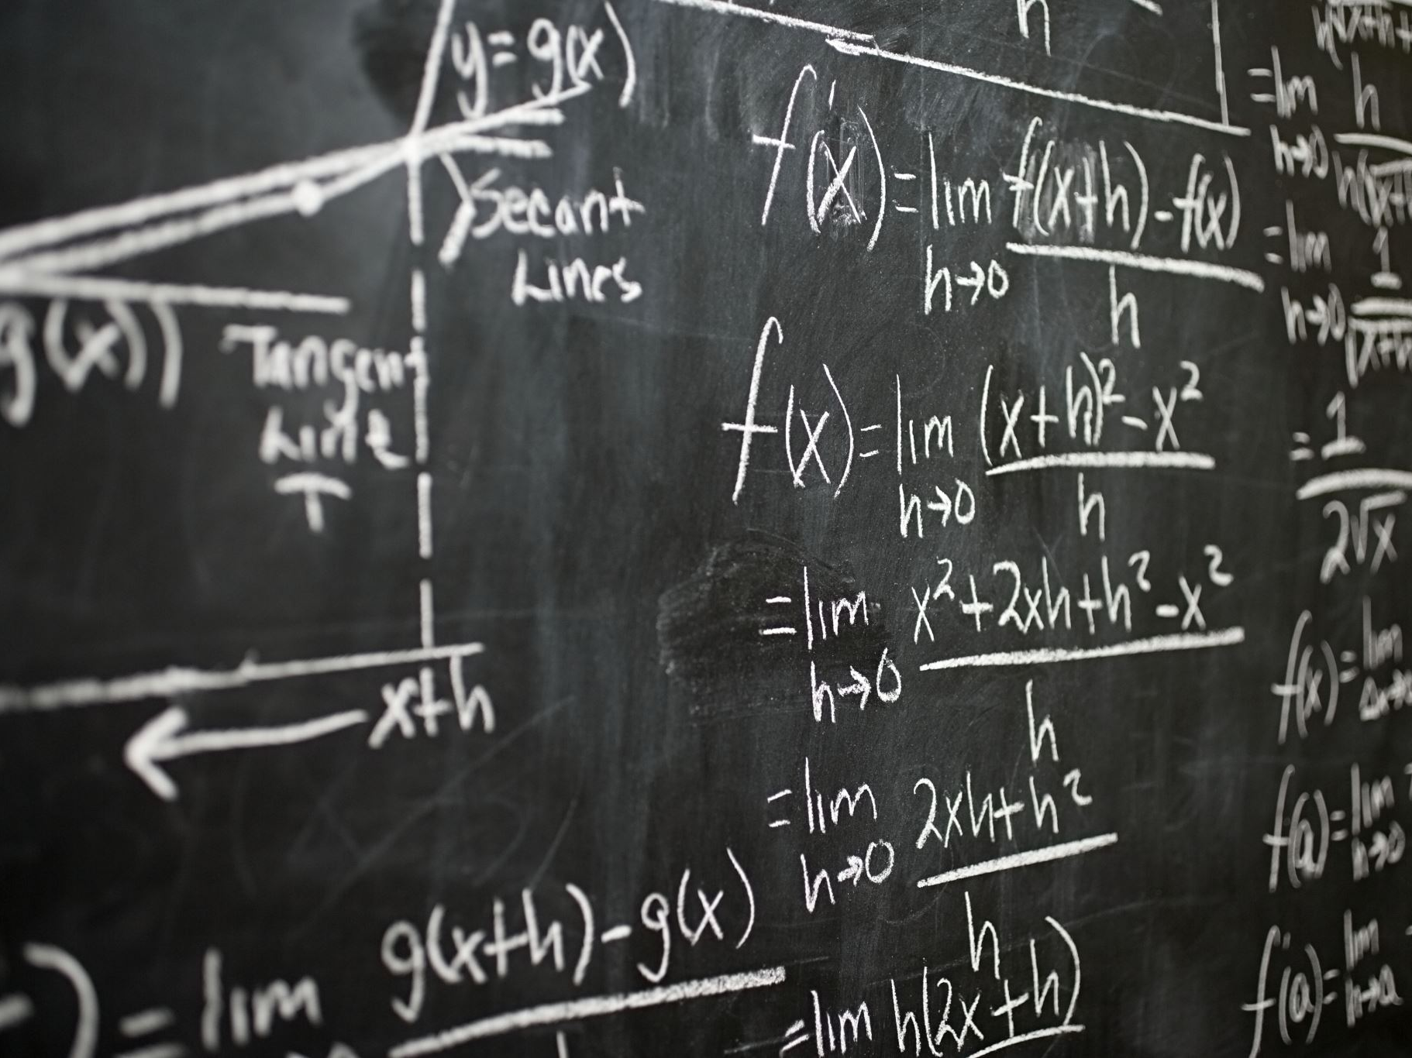
CLASS DIAGRAM

Slide 15
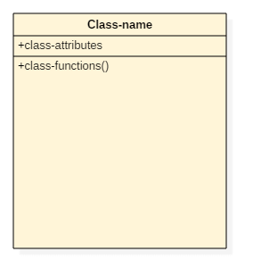
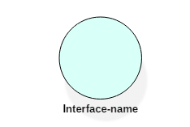
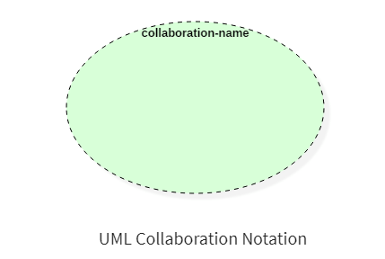
Common Notation
Class:
Interface:
Collaboration:

Slide 16
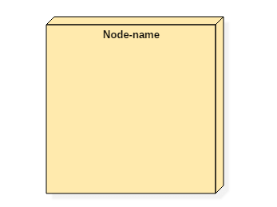
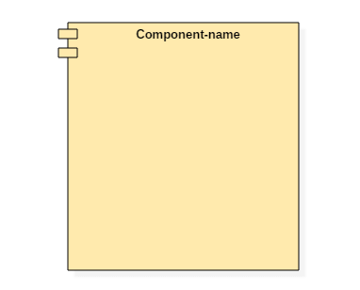
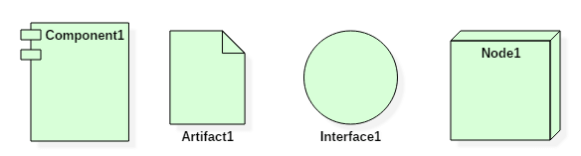
Common Notation
Node:
Component::
Deployment diagram:

Slide 17
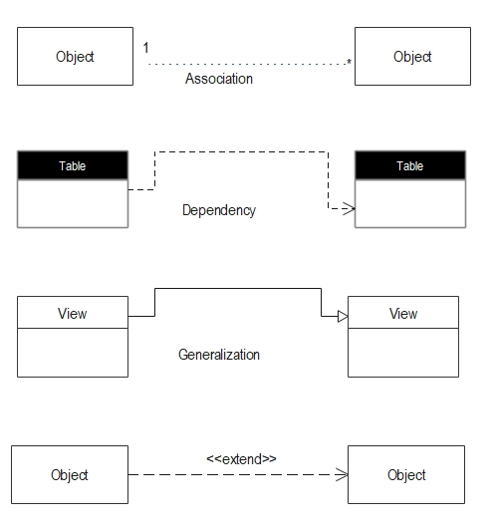
Relationships

Slide 18
Association

Slide 19
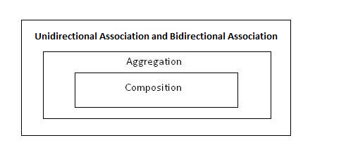
Unidirectional
Bidirectional
Aggregation
Composition

Slide 20
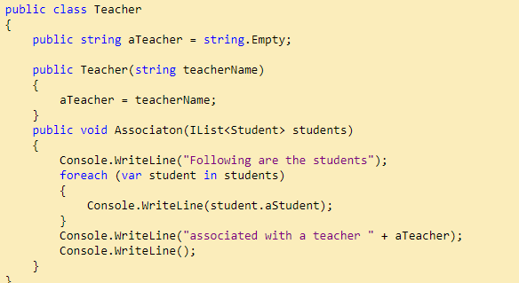
Unidirectional Association is a specialized form of association where one object is associated with another object, but the reverse is not true. It is like one way communication.
Let’s take examples of multiple students can associate with a single teacher.

Slide 21
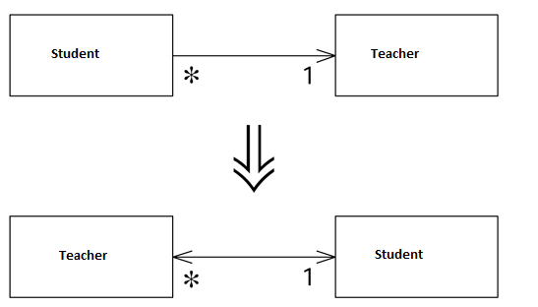
bidirectional Association

Slide 22
Aggregation
Aggregation is a specialized form of Association where all objects have their own life cycle but there is ownership and child object cannot belong to another parent object.

Slide 23
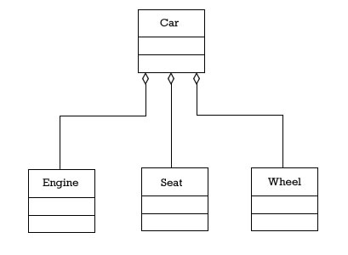
Aggregation
A car object is an aggregation of engine, seat, wheels and other objects

Slide 24
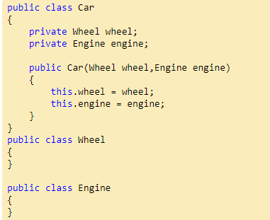
Aggregation
A car object is an aggregation of engine, seat, wheels and other objects
We can think about “has-a” relationship.

Slide 25
Composition
Composition is again a specialized form of Aggregation and we can call this as a “death” relationship. It is a strong type of Aggregation. A child object does not have its life cycle and if parent object deletes, all child objects will also be deleted.

Slide 26
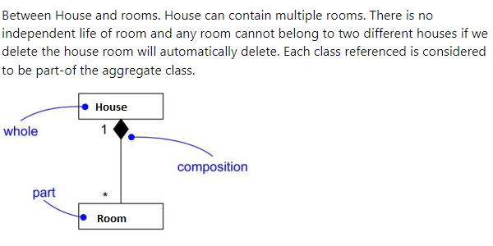
Composition

Slide 27
Reflexive association
Links can exist between instances of the same class, for example, between nodes in a ring network or authors of a book. Associations that have the same class at both ends are known as reflexive associations.
Definition: A reflexive association is an association between instances of the same class.

Slide 28
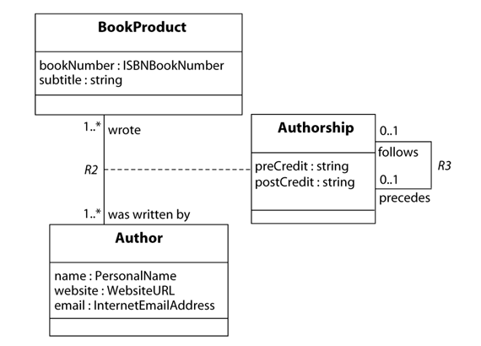
Reflexive association

Slide 29
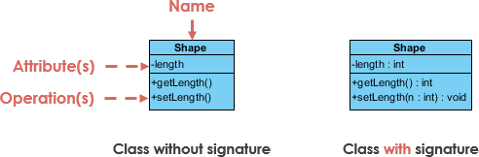
UML Class Notation
A class represent a concept which encapsulates state (attributes) and behavior (operations). Each attribute has a type. Each operation has a signature. The class name is the only mandatory information.

Slide 30
UML first pass: Class diagrams
Association
Class
Multiplicity
Watch
1
1
1
1
2
1
2
1
PushButton
LCDDisplay
Battery
load
Time
now
state
blinkIdx
blinkSeconds()
blinkMinutes()
blinkHours()
stopBlinking()
referesh()
push() release()
Attribute
Operations

Slide 31
Some links
https://www.uml-diagrams.org/uml-25-diagrams.html
https://www.lucidchart.com/pages/what-is-UML-unified-modeling-language/#section_0

Slide 32
Any thing to ask ??

